Slide 1
Discrete Mathematics
Set theory Webinar
Dr Lahcen Ouarbya

Slide 2
Introduction
Set theory is a branch of mathematics that deals with the properties of well-defined collections of objects.
Set theory forms the basis of several other fields of study such as counting theory, relations, graph theory and finite state machines.
In this topic we will cover the basic elements of set theory.

Slide 3
Outlines
Definition of set and set notions
Set representation
Powerset of a set
Set operations
Venn diagram
Partition
Notes:
This is what I will be talking about in this talk:
definition of a set
Element of a set
The concept of a subset of a set
And cardinality of set

Slide 4
Definition of a set
Mathematicians use the term set to refer to a collection of any kind of objects: people, ideas or numbers, for example.
A set is a well-defined collection of any kind of objects:
V
C
Empty Set
E
2 4
6
8
a e
i o u
red
green
blue
…
Set of positive even
integers less than 10
Set of vowels in the
English alphabet
Set of colours
Empty set
Notes:
1st
The term set is used by mathematicians to refer to a collection of any king of objects:
People, numbers, ideas. …
2nd
A set is well defined collection of any kind of objects
3rd
Set of positive even integer less than 10. called E
4th
Set of vowels in the English alphabet called V
5th
Set of colours called C
6th
Empty set

Slide 5
Set notation
Set of positive even
integers less than 10
Set of vowels in the
English alphabet
Empty set
E
2 4
6
8
V
a e
i o u
Empty Set
E={2,4,6,8}
V={a,e,i,o,u}
Empty Set={}=∅
Notes:
1st
In mathematics we write
The set E (positive even integers less than 10) as E={2,4,6,8}.
2nd
The V (vowels in the English alphabet) as V={a,e,I,o,u}
3rd
The set C (Colours) as C={ red, green, blue, …}
4th
The empty set as EmptySet={}=∅

Slide 6
Definition of a set (cont’d)
Definition: A set is an unordered collection of unique objects.
2 4
6
8
4 6
2
8
2 4
2 6
8 8
unordered
and
unique
=
=
{2,4,6,8} = {4,6,2,8} = {2,4,2,6,8,8}
Notes:
The order objects in a set is not important
The set of even integers less than 10, E, can be written as {2,4,6,8} or {4,6,2,8}

Slide 7
Element of a set. (∈)
Set of positive even
integers less than 10
Set of vowels in the
English alphabet
V
a e
i o u
E
2 4
6
8
E={2,4,6,8}
V={a,e,i,o,u}
2 ∈ E (2 is an element of E)
3 ∉ E (3 is not an element of E)
e ∈ V (2 is an element of V)
s ∉ V (s is not an element of V)
Notes:
2 is an element of E, we write:
3 is not an element of E, we write:
The same as e is an element of V whereas s is not an element of V

Slide 8
Cardinality of a set (Card)
Definition: Given a set S, the cardinality of S is the number of elements contained in S. We write the cardinality of S as |S|.
2 4
6
8
a e
i o u
E={2,4,6,8}
V={a,e,i,o,u}
Empty Set={}=∅
E contains 4 elements,
hence, |E| = 4
V contains 5 elements,
hence, |V| = 5
|{}|=| ∅ | = 0
Notes:
Given set S. the cardinality of S is the number of number of element.
The cardinality of S can be written as |S|.

Slide 9
Subset of a set (⊆)
Definition:
A is said to be a subset of B if and only if every element of A is also an element of B. In this case we write A ⊆ B
That is, we have the equivalence:
A ⊆ B ⇔ if x ∈ A then x ∈ B (for all x)
Notes:
Given two sets A and B, A is called a subset of B if and only if every element of A is an element of B
We write:A ⊆ B

Slide 10
Example (⊆)
E= {2,4,6,8}
V= {a,i,e,o,u}
2 4
6
8
a e
i o
u
2
6
a
i
{2,6} ⊆ E
{a,i} ⊆ V
{2,3} ⊈E
{a,b} ⊈ V
Notes:
The set {2,6} is subset {2,4,6,8} as 2 and are also element of {2,4,6,8}
The set {2,3} is not a subset {2,4,6,8} as 3 is not element of {2,4,6,8}
The same for the set of vowels

Slide 11
Empty set is a subset of any set (∅ ⊆ S)
∅
{} = ∅
∅
2 4
6
8
{} = ∅ ⊆ {2,4,6,8}
∅ ⊆ ∅
Notes:
An Empty set is a subset of any set.

Slide 12
Any set is a subset of itself (S ⊆ S)
E ={2,4,6,8}
2 4
6
8
4
6
8
{2,4,6,8}=E
E ⊆ E
Notes:
A set is subset of itself.

Slide 13
Special sets: N, Z, Q, R
𝐍 = set of natural numbers = {1,2,3,4, …}
𝐙 = set of integers = {… , -3, -2, -1, 0, 1, 2, 3, …}
𝐐 = set of rational numbers (of form a/b where a and b are elements of Z and b ≠ 0)
𝐑 = set of real numbers
𝐍 ⊆ 𝐙 ⊆ 𝐐 ⊆ 𝐑
Notes:
𝐍 = set of natural numbers
𝐙 = set of integers
𝐐 = set of rational numbers of form a/b where a and b are element of Z
𝐑 = set of real numbers

Slide 14
Set representation:
Listing method.
Set builder notation (rules of inclusion).
Notes:
In this lecture we will be talking about different ways of representing a set:
Listing method
Set builder notation (rules of inclusion)
Conversion between these two methods

Slide 15
Listing method
Representing a set S using the listing method consists of listing all the elements of S.

Slide 16
Listing method
Description:
S1= set of all vowels in the English alphabet.
S1 ={a, e, i, o, u}. (listing method)
Description:
S2= set of all positive integers less 10.
S2= {1, 2, 3, 4, 5, 6, 7, 8, 9} (listing method)
Description:
S3= set of all positive even integers less than 10.
S3= {2, 4, 6, 8 } (listing method)
Notes:
We have already used the listing method to represent a set
In the listing method we just list all the elements of a s set.
As you can see the set of all vowels ls the English aphabet is S1 ={a, e, i, o, u}
S2 the set of all positive integers less than 10.
S3 S3= set of all positive even integers less than 10

Slide 17
Set builder notation
Assume we want to describe the set of all even integers
{…,-6 ,-4,-2, 0, 2, 4, 6, …}
2*(-3)
2*(-2)
2*(-1)
2*0
2*1
2*2
2*3
Even = {2n | n ∈ Z }
Set builder notation
Notes:
This set represents all even integers. All even integers can be written as 2n where n is an integer.
Hence, we can represents Even set as follow:
This called the set builder notation

Slide 18
Set builder
Assume we want to describe the set of all odd integers
{… , -5, -3, -1, 1, 3, 5, 7, …}
2*(-3)+1
2*(-2)+1
2*(-1)+1
2*0+1
2*1+1
2*2+1
2*3+1
Odd = {2n+1 | n ∈ Z }
Notes:
This set represents all odd integers. As you can see all odd integers can be written as 2n+1 where n is an integer.
Hence, we can represents odd set as follow:
This called the set builder notation

Slide 19

Set builder (notation)
Assume we want to describe the set of rational numbers Q
Q={…, 1/1, ½, 1/3, ¼, …}
Q ={$\frac{n}{m}$| n, m ∈ Z and m ≠ 0 }
Notes:
The set of rational numbers Q can be written as follow:

Slide 20
Set builder notation
The set of things in my bag:
Bag = {pen, book, laptop, …}
The set of things in my bag:
Bag = {x| x is in my bag}
Notes:
the set of things in my bag can represented:
By listing the the objects in my bag. (listing)
Or
By saying anything in my bag is an element ( set builder)

Slide 21

Exercise
Rewrite the following sets using the listing method:
S₁ = {3n | n ∈ N and n < 6}
S₁ = {3*1, 3*2, 3*3, 3*4, 3*5}
S₁ = {3, 6, 9, 12, 15}
S₂ = {2^{n} | n ∈ Z and 0 ≤ n ≤ 4}
S₂ = {2⁰, 2¹, 2², 2³, 2⁴}
S₂ = {1, 2, 4, 8, 16}
S₃ = {2^{-n} | n ∈ Z and 0 ≤ n < 8}
S₃ = {2⁰, 2⁻¹, 2⁻², 2⁻³, 2⁻⁴ , 2⁻⁵ , 2⁻⁶ , 2⁻⁷ }
S₃ = {1, $\frac{1}{2}\text{, }\frac{1}{4}$ , $\frac{1}{8}$ , $\frac{1}{16}$ , $\frac{1}{32}$ , $\frac{1}{64}$ , $\frac{1}{128}$}

Slide 22



Exercise
Rewrite the following sets using the listing method:
S₁ = {$\frac{1}{2}\text{, }\frac{1}{4}$ , $\frac{1}{6}$ , $\frac{1}{8}$ , $\frac{1}{10}$ }
S₁ = {$\frac{1}{2∗1}\text{, }\frac{1}{2∗2}$ , $\frac{1}{2∗3}$ , $\frac{1}{2∗4}$ , $\frac{1}{2∗5}$}
S₁ = {$\frac{1}{2n}$| n ∈ Z and 0 < n ≤ 5}
S₂ = {1, 2, 4, 8, 16, 32, 64, 128}
S₁ = {2⁰, 2¹, 2², 2³, 2⁴ , 2⁵ , 2⁶ , 2⁷}
S₂ = {2^{n}| n ∈ Z and 0 ≤ n ≤ 7}
S₃ = {… , -9, -6, -3, 0, 3, 6, 9,…}
S₃ = {… , -3*3, -2*3, -1*3, 0*3, 1*3, 2*3, 3*3, …}
S₃ = {3n | n ∈ Z}

Slide 23
Summary
Description method:
S1= set of all vowels in the English alphabet.
S2= set of all natural positive numbers less 10.
S3= set of all natural positive even numbers less than 10.
Listing method:
S1 ={a, e, i, o, u}
S2= {1, 2, 3, 4, 5, 6, 7, 8, 9}
S3= {2, 4, 6, 8 }
Set builder notation (rules of inclusion):
S1 ={c| c is in the English alphabet and c is a vowel}
S2= {n| n ∈ N and n < 10}
S3= {2n| n ∈ N and n <5}

Slide 24
Powerset of a set
Definition of a powerset of a set.
Cardinality of a powerset of a set.
Notes:
After this lecture you will be able to understand:
What is is powerset of a set
The relation between the cardinality of a set and that of its corresponding powerset.

Slide 25
Powerset of a set
Definition: given a set S, the powerset of S, P(S), is the set containing all the subsets of S.

Slide 26
Example
Given a set S={1, 2, 3}
The subsets of S are:
∅,{1},{2},{3},
{1,2},{1,3},{2,3},
{1,2,3}
P(S) = {∅,{1},{2},{3},{1,2},{1,3},{2,3},{1,2,3}}

Slide 27
Exercise 1
Given a set S={a, b}.
Write down the P(S).
Is {a} an element or a subset of P(S)?
Is the empty set an element or a subset of P(S)?

Slide 28
Cardinality of a powerset
Given a set S, then | P(S) | = 2^{|S|}
Example
S={1,2,3}. |S| = 3
P(S) = {∅,{1},{2},{3},{1,2},{1,3},{2,3},{1,2,3}}
| P(S) | = 8 = 2³ = 2^{|S|}

Slide 29

Exercise 3
Given a set A, If |A| = n, find |P(P(P(A)))|.
Solution:
|P(A)| = 2^{|A|} = 2^{n}
|P(P(A))| = 2^{|P(A)|} = $2^{2^{n}}$
|P(P(P(A)))| = 2^{|P(P(A))|} = $2^{2^{2^{n}}}$

Slide 30
Exercise
Let A and B be two sets and let |A| = n and |B|=m. Find |P(AxB)|.
Solution:
|AxB| = |A| x |B| = n x m
|P(AxB)| = 2^{|AxB|} = 2^{nxm}

Slide 31
Set operations
set union
set intersection
set difference
symmetric difference.

Slide 32
Union (A U B)
Definition:
Given two sets A and B, the union of A and B, AUB, contains all the elements in EITHER A or B.
A U B = { x | x ∈ A or x ∈ B }

Slide 33
Example:
AUB
A
B
1
3 5
7 2 4
6 8 9
2
4 6
8
1
3 5
7 9
U
=
A={2, 4, 6, 8}
B={1, 3, 5, 7, 9}
AUB={2, 4, 6, 8, 1, 3, 5, 7, 9}

Slide 34
Membership table (A U B )
Membership tables show all the combinations of sets an element can belong to:
1 means the element belongs to the set
0 means it does not belong to the set.
A | B | A U B
0 | 0
0 | 1
1 | 0
1 | 1
 |  | 0
 |  | 1
 |  | 1
 |  | 1

Slide 35
Intersection (A ∩ B )
Definition:
Given two sets A and B, the intersection of A and B, A ∩ B, contains all the elements in both A and B.
A ∩ B = { x | x ∈ A and x ∈ B }

Slide 36
Example
A
A ∩ B
2
4 6
3 7
B
1
3 5
7 9
3
7
∩
=
A={2, 3, 4, 6, 7}
B={1, 3, 5, 7, 9}
A ∩ B={3, 7}

Slide 37
Membership table (A ∩ B )
A | B | A ∩ B
0 | 0
0 | 1
1 | 0
1 | 1
 |  | 0
 |  | 0
 |  | 0
 |  | 1

Slide 38
Set difference (A−B )
Definition:
Given two sets A and B, the set difference, A−B, contains the elements that are in A but not in B
A - B = { x | x ∈ A and x ∉ B }

Slide 39
Example
A
B
A−B
2
4 6
3 7
1
3 4
5 7
2
6
-
=
A={2, 3, 4, 6, 7}
B={1, 3, 4, 5, 7}
A−B={2, 6}

Slide 40
Membership table (A−B )
A | B | A−B
0 | 0
0 | 1
1 | 0
1 | 1
 |  | 0
 |  | 0
 |  | 1
 |  | 0

Slide 41
Symmetric difference (A ⊕ B )
Definition:
Given two sets A and B, the symmetric difference, A ⊕ B, contains the elements that are in A or in B but not in both.
A ⊕ B = { x | (x ∈ A or x ∈ B) and x ∉ A ∩ B}
A ⊕ B = (A U B) – (A ∩ B)

Slide 42
Example:
A
B
A ⊕ B
2
4 6
3 7
1
3 4
5 7
1 2
6 5
⊕
=
A={2, 3, 4, 6, 7}
B={1, 3, 4, 5, 7}
A ⊕ B={1, 2, 5, 6}

Slide 43
Membership table (A ⊕ B )
A | B | A ⊕ B
0 | 0
0 | 1
1 | 0
1 | 1
 |  | 0
 |  | 1
 |  | 1
 |  | 0

Slide 44
Examples:
A={1, 2, 3} and B = {3, 4, 5}
A U B= {1, 2, 3, 4, 5}
A ∩ B= {3}
A−B={1, 2}
A ⊕ B={1, 2, 4, 5}

Slide 45
Membership table (A ⊕ B )
A | B | A ⊕B
0 | 0 | 0
0 | 1 | 1
1 | 0 | 1
1 | 1 | 0

Slide 46
Summary
A | B | A U B | A ∩ B | A−B | A ⊕ B
0 | 0 | 0 | 0 | 0 | 0
0 | 1 | 1 | 0 | 0 | 1
1 | 0 | 1 | 0 | 1 | 1
1 | 1 | 1 | 1 | 0 | 0
0
1
1
1
0
0
0
1
0
0
1
0
0
1
1
0

Slide 47
Exercise
Given two sets A and B, by using the membership table show that:
A ∩ B= B−(B−A)
Because the two indicated columns have the same values, the two expressions are identical

Slide 48
Venn diagrams
Notion of the universal set.
The complement of a set.
Set representation using Venn diagrams.

Slide 49
Universal set
A universal set is a set that contains everything. We note the universal set with the letter U.

Slide 50
Venn diagrams
A Venn diagram is used to visualise the possible relations among a collection of sets.
U

Slide 51
Venn diagram A ⊆ U
U is called the universal set and it contains everything.
A ⊆ U (A is in red).
U
A

Slide 52
Complement of a set
The complement of a set A , Ā, contains all the elements in the universal set U but not in A.
Ā = U−A

Slide 53
Example
U={1, 2, 3, 4, 5,6.7, 8, 9, 10}
and
A={2, 4, 6. 8, 10}
then
Ā={1, 3, 5, 7, 9}

Slide 54
Complement of a set A
Ā U A = U

Slide 55
Venn diagram for Ā
U
A

Slide 56
Venn diagram for A U B
A U B
U
A
B

Slide 57
Venn diagram for A ∩ B
A ∩ B
U
A
B

Slide 58
Venn diagram for A−B
A−B
U
A
B

Slide 59
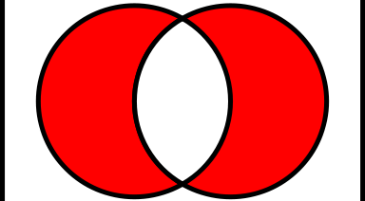
Venn diagram for A ⊕ B
U
A
B

Slide 60
Example:
Use Venn diagram to show that
A ⊕ B = AUB−(A ∩ B)

Slide 61
Show that A ⊕ B = AUB−(A ∩ B)
U
A ⊕ B
A
B
U
AUB−(A ∩ B)
A
B

Slide 62
De Morgan’s law
De Morgan's Laws describe how mathematical statements and concepts are related through their opposites. In set theory, De Morgan's Laws relate the intersection and union of sets through complements.

Slide 63
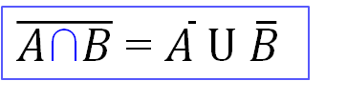
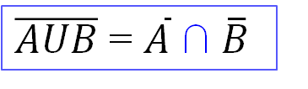
De Morgan’s law
The complement of the union of two sets A and B is equal to the intersection of their complements.
$\overline{AUB}$ = $\overline{A} \text{∩}$ $\overline{B}$
The complement of the intersection of two sets A and B is equal to the union of their complements.
$\overline{A\text{∩}B}$ = $\overline{A} \text{U}$ $\overline{B}$

Slide 64
Proof correctness of De Morgan’s law using membership table

Slide 65
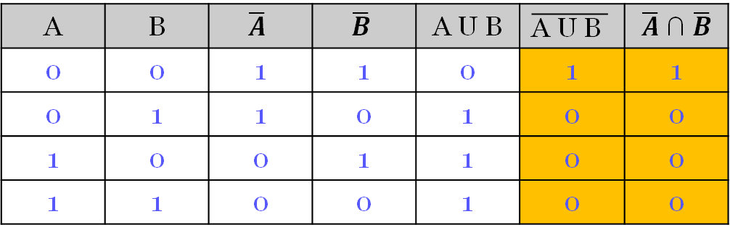

$\overline{\text{A} \text{U} \text{B} }$ = $\overline{A}$ $\text{∩}$ $\overline{B}$ Proof using membership table
A | B | $$\overline{A}$$ | $$\overline{B}$$ | A U B | $$\overline{\text{A} \text{U} \text{B} }$$ | $\overline{A}$ $\text{∩}$ $\overline{B}$
0 | 0 | 1 | 1 | 0 | 1 | 1
0 | 1 | 1 | 0 | 1 | 0 | 0
1 | 0 | 0 | 1 | 1 | 0 | 0
1 | 1 | 0 | 0 | 1 | 0 | 0
Both orange columns are the same, therefore both expressions equivalent.

Slide 66


$\overline{\text{A} \text{∩ }\text{B} }$ = $\overline{A}$ U $\overline{B}$ Proof using membership table
A | B | $$\overline{A}$$ | $$\overline{B}$$ | A ∩ B | $$\overline{\text{A} \text{∩ }\text{B} }$$ | $\overline{A}$ U $\overline{B}$
0 | 0 | 1 | 1 | 0 | 1 | 1
0 | 1 | 1 | 0 | 0 | 1 | 1
1 | 0 | 0 | 1 | 0 | 1 | 1
1 | 1 | 0 | 0 | 1 | 0 | 0
Both orange columns are the same, therefore both expressions are equivalent.

Slide 67
Proof correctness of De Morgan’s law using Venn diagrams

Slide 68






$\overline{\text{A} \text{U} \text{B} }$ = $\overline{A}$ $\text{∩}$ $\overline{B}$ Proof using Venn diagrams
$$\overline{\text{A}}$$
A U B
U
U
A
B
A
B
$$\overline{\text{B}}$$
U
A
B
$$\overline{\text{A} \text{U} \text{B} }$$
U
$\overline{A}$ $\text{∩}$ $\overline{B}$
A
B
U
A
B
$\overline{\text{A} \text{U} \text{B} }$ = $\overline{A}$ $\text{∩}$ $\overline{B}$

Slide 69



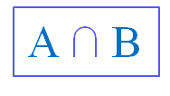

$\overline{\text{A} \text{∩ }\text{B} }$ = $\overline{A}$ U $\overline{B}$ Proof using Venn diagrams
$$\overline{\text{A}}$$
A $\text{∩}$ B
U
U
A
B
A
B
$$\overline{\text{B}}$$
U
A
B
$$\overline{\text{A}\text{∩}\text{B} }$$
U
$\overline{A}$ $U$ $\overline{B}$
A
B
U
A
B
$\overline{\text{A}\text{∩}\text{B} }$ = $\overline{A}$ $U$ $\overline{B}$

Slide 70
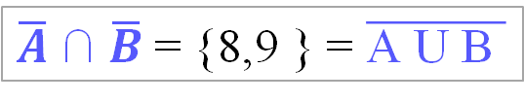
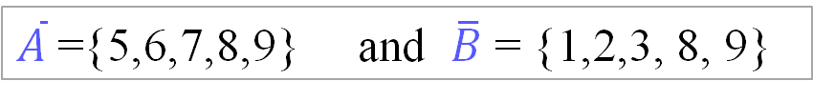
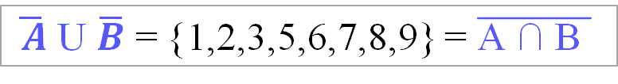
Example:
Given U= {1,2,3,4,5, 6,7,8,9 } and A, B two subsets of U
A={1,2,3,4} and B = {4, 5, 6, 7}
A U B ={1,2,3,4, 5,6,7} and A $\text{∩}$ B= {4}
$\overline{\text{A} \text{U} \text{B} }$ ={8, 9} and $\overline{\text{A} \text{∩ }\text{B} }$= {1,2,3,5,6,7,8,9}
$\overline{A}$={5,6,7,8,9} and $\overline{B}$ = {1,2,3, 8, 9}
$\overline{A}$ $\text{∩}$ $\overline{B}$= {8,9 } = $\overline{\text{A} \text{U} \text{B} }$
$\overline{ A}$ U $\overline{B}$ = {1,2,3,5,6,7,8,9} = $\overline{\text{A} \text{∩ }\text{B} }$

Slide 71
Exercise
Draw a general Venn diagram to show three subsets A, B and C of U
intersecting in the most general way.
Label each section of the diagram with the appropriate 3-bit binary code.
Shade all the regions contained in the subset S defined by the membership table below:
Describe the subset S in terms of the sets A, B and C using any appropriate set operations.
Given Three sets A, B and C,

Slide 72
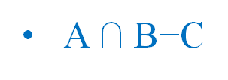
Solution
Venn diagram for A, B and C
Venn diagram for S
A $\text{∩}$ B−C

Slide 73
Set identities:
Commutative
associative
distributive.

Slide 74
Commutativity
A U B = B U A
A ∩ B = B ∩ A

Slide 75
Associativity
(A U B) U C = A U (C U B)
(A ∩ B) ∩ C = A ∩ (B ∩ C)

Slide 76
Distributivity
A U (B ∩ C) = (A U B ) ∩ (A U C)
A ∩ (B U C) = (A ∩ B ) U (A ∩ C)

Slide 77
Proof by membership tables 1
The following membership table shows that the union of sets is distributive over the intersection of sets.
A | B | C | B∩C | A U (B ∩ C) | AUB | AUC | (AUB) ∩ (AUC)
0 | 0 | 0 | 0 | 0 | 0 | 0 | 0
0 | 0 | 1 | 0 | 0 | 0 | 1 | 0
0 | 1 | 0 | 0 | 0 | 1 | 0 | 0
0 | 1 | 1 | 1 | 1 | 1 | 1 | 1
1 | 0 | 0 | 0 | 1 | 1 | 1 | 1
1 | 0 | 1 | 0 | 1 | 1 | 1 | 1
1 | 1 | 0 | 0 | 1 | 1 | 1 | 1
1 | 1 | 1 | 1 | 1 | 1 | 1 | 1
Both columns highlighted in green are the same,
hence: AU (B ∩ C) = (A U B) ∩ (A U C)
77

Slide 78
Proof by membership tables 2
The following membership table shows that the intersection of sets is distributive over the union of sets.
A | B | C | BUC | A∩ (B U C) | A∩B | A∩C | (A∩B) U (A∩C)
0 | 0 | 0 | 0 | 0 | 0 | 0 | 0
0 | 0 | 1 | 1 | 0 | 0 | 0 | 0
0 | 1 | 0 | 1 | 0 | 0 | 0 | 0
0 | 1 | 1 | 1 | 0 | 0 | 0 | 0
1 | 0 | 0 | 0 | 0 | 0 | 0 | 0
1 | 0 | 1 | 1 | 1 | 0 | 1 | 1
1 | 1 | 0 | 1 | 1 | 1 | 0 | 1
1 | 1 | 1 | 1 | 1 | 1 | 1 | 1
Both columns highlighted in green are the same,
hence: A∩ (B UC) = (A ∩ B) U (A ∩ C)
78

Slide 79
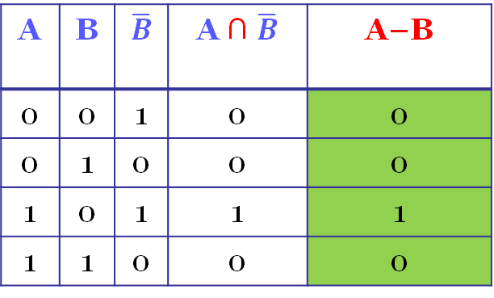

Set identity: A-B= $A$ $\text{∩}$ $\overline{B}$
Proof:
A | B | $$\overline{B}$$ | A ∩ $\overline{B}$ | A−B
0 | 0 | 1 | 0 | 0
0 | 1 | 0 | 0 | 0
1 | 0 | 1 | 1 | 1
1 | 1 | 0 | 0 | 0

Slide 80
Exercise
Given two sets, A and B, show that (A−B)−B = A−B using set identities.

Slide 81
Partition of set
A partition of an object is a division of the object into parts so that these parts are completely separated from each other and together they form the whole object.
Data partitioning has many applications in computer sciences e.g. big data analysis.

Slide 82
Dis-joint sets
Two sets A and B are disjoint if and only if A ∩ B = ∅
B
U
A

Slide 83
Partition
Definition
A partition of 𝐴 is a set of subsets A_{i} of 𝐴 such that:
all the subsets A_{i} are dis-joints
the union of all subsets A_{i} is equal to A.
Given A₁ ,A₂ ,…,A_{n} are subsets of A.
{A₁ ,A₂ ,…,A_{n} } is a partition of 𝐴 if and only:
all the subsets A_{i} are dis-joints
A_{i} ∩ A_{j} = ∅ for i ≠ j and I,j=1,2,…,n
the union of all subsets, A_{i}, is equal to A.
A= A₁ U A₂ U, …, U A_{n}

Slide 84
Example:
A₁ ∩ A₂ = A₁ ∩ A₂ = …= A₄ ∩ A₅ = ∅
A= A₁ U A₂ U A₃ U A₄ U A₅
{A₁, A₂, A₃, A₄, A₅ } is a partition on A

Slide 85
Exercise:
Given a set S = {1,2,3,4,5}, which one of the following is a partition of S?
{{1,2}, {3,4}, {5}}
{{1,2}, {3,4}, {4,5}}
{{1,2}, {3}, {4}}

Slide 86
Solution
{{1,2}, {3,4}, {5}} is a partition of S as
{1,2} U {3,4} U {5} = {1, 2, 3, 4, 5}= S
{1,2} ∩{3,4} ={1,2} ∩ {5} ={3,4} ∩ {5}= ∅
{{1,2}, {3,4}, {4,5}} is not a partition as
{3,4} ∩ {4,5} = {4} ≠ ∅
{{1,2}, {3}, {4}} is not a partition as
{1,2} U {3} U {4}={1,2,3,4} ≠ S

Slide 87
Exercise
Given two sets A and B, show that (AUB) − B=A − B

Slide 88
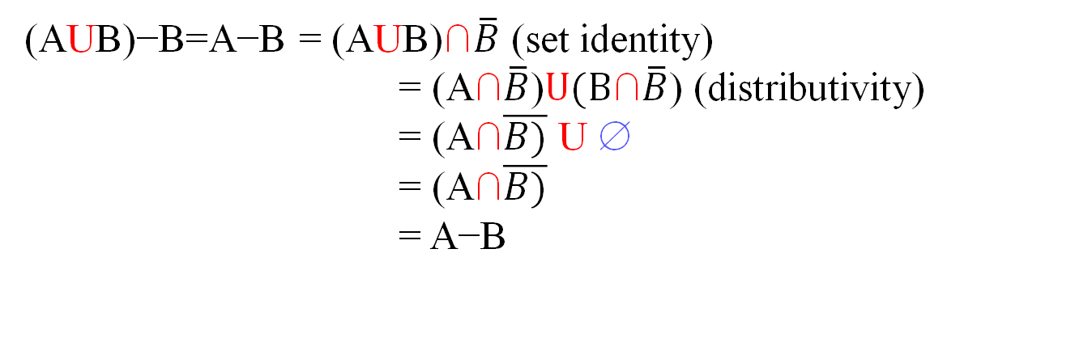
Solution:
(AUB)−B=A−B = (AUB)$\text{∩}\overline{B}$ (set identity)
= (A$\text{∩}\overline{B}$)$U(\text{B}\text{∩}\overline{B}$) (distributivity)
= (A$\text{∩}\overline{B)}$ U ∅
= (A$\text{∩}\overline{B)}$
= A−B
This can be also be shown using a membership table:
A | B | AUB | (AUB)−B | A−B
0 | 0 | 0 | 0 | 0
0 | 1 | 1 | 0 | 0
1 | 0 | 1 | 1 | 1
1 | 1 | 1 | 0 | 0

Slide 89
Summary
Definition of set and set notions
Set representation
Powerset of a set
Set operations
Venn diagram
Partition
Notes:
This is what I will be talking about in this talk:
definition of a set
Element of a set
The concept of a subset of a set
And cardinality of set

